Slide 1
E-retail factors for customer activation and retention: A case study from Indian e-commerce customers

Slide 2
PROBLEM STATEMENT:
Customer satisfaction has emerged as one of the most important factors that guarantee the success of online store; it has been posited as a key stimulant of purchase, repurchase intentions and customer loyalty. A comprehensive review of the literature, theories and models have been carried out to propose the models for customer activation and customer retention. Five major factors that contributed to the success of an e-commerce store have been identified as: service quality, system quality, information quality, trust and net benefit. The research furthermore investigated the factors that influence the online customers repeat purchase intention. The combination of both utilitarian value and hedonistic values are needed to affect the repeat purchase intention (loyalty) positively. The data is collected from the Indian online shoppers. Results indicate the e-retail success factors, which are very much critical for customer satisfaction.
Be careful: There are two sheets (one is detailed) and second is encoded in the excel file. You may use any of them by extracting in separate excel sheet. The number of column(s) is more than 47. Read the column header carefully.
Note : Data Scientists have to apply their analytical skills to give findings and conclusions in detailed data analysis written in jupyter notebook . Only data analysis is required.
Need not to create machine learning models /but still if anybody comes with it that is welcome

Slide 3
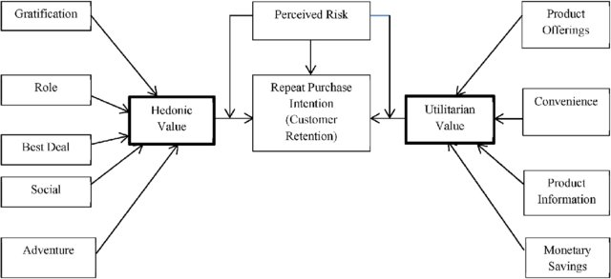
PROBLEM STATEMENT:

Slide 4
INTRODUCTION:
The purpose of this study is to analyse the factors that contribute to the success of e-commerce players
And most importantly analyse the factors that affect the repeat purchase mentality of customers.
Five major factors that contributed to the success of an e-commerce store have been identified as: service quality, system quality, information quality, trust and net benefit.
The combination of both utilitarian value and hedonistic values are needed to affect the repeat purchase intention (loyalty) positively.

Slide 5
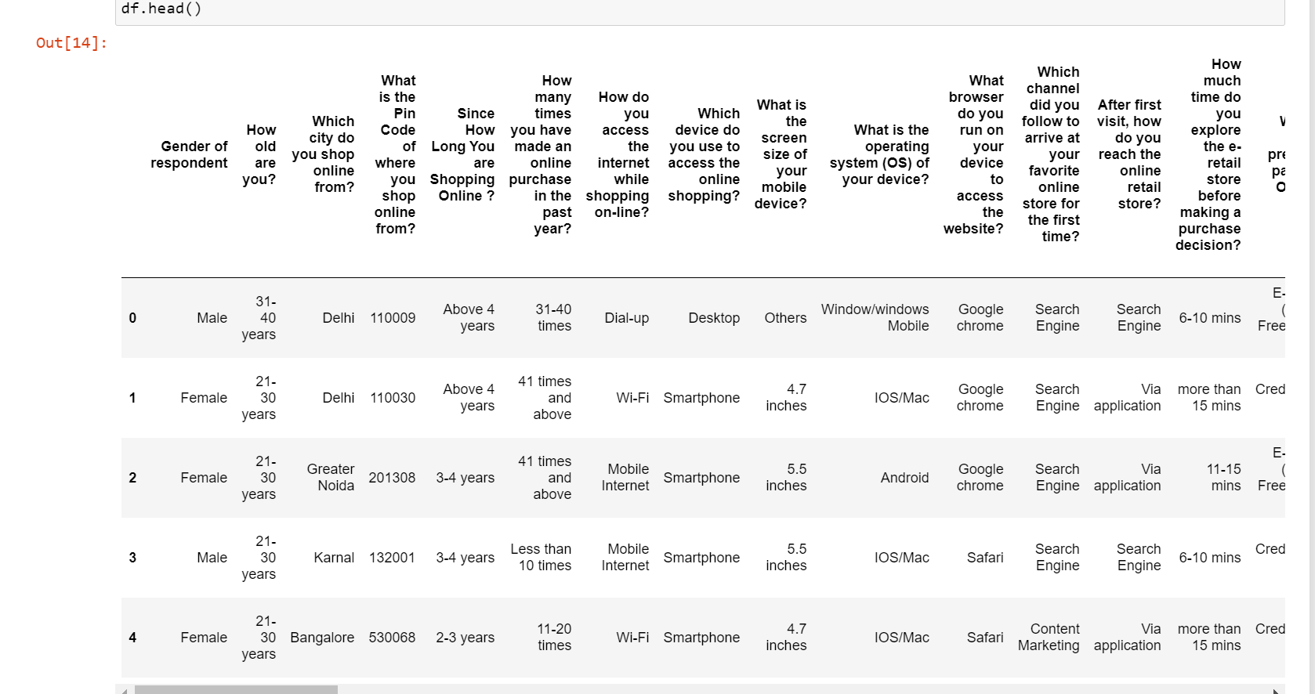
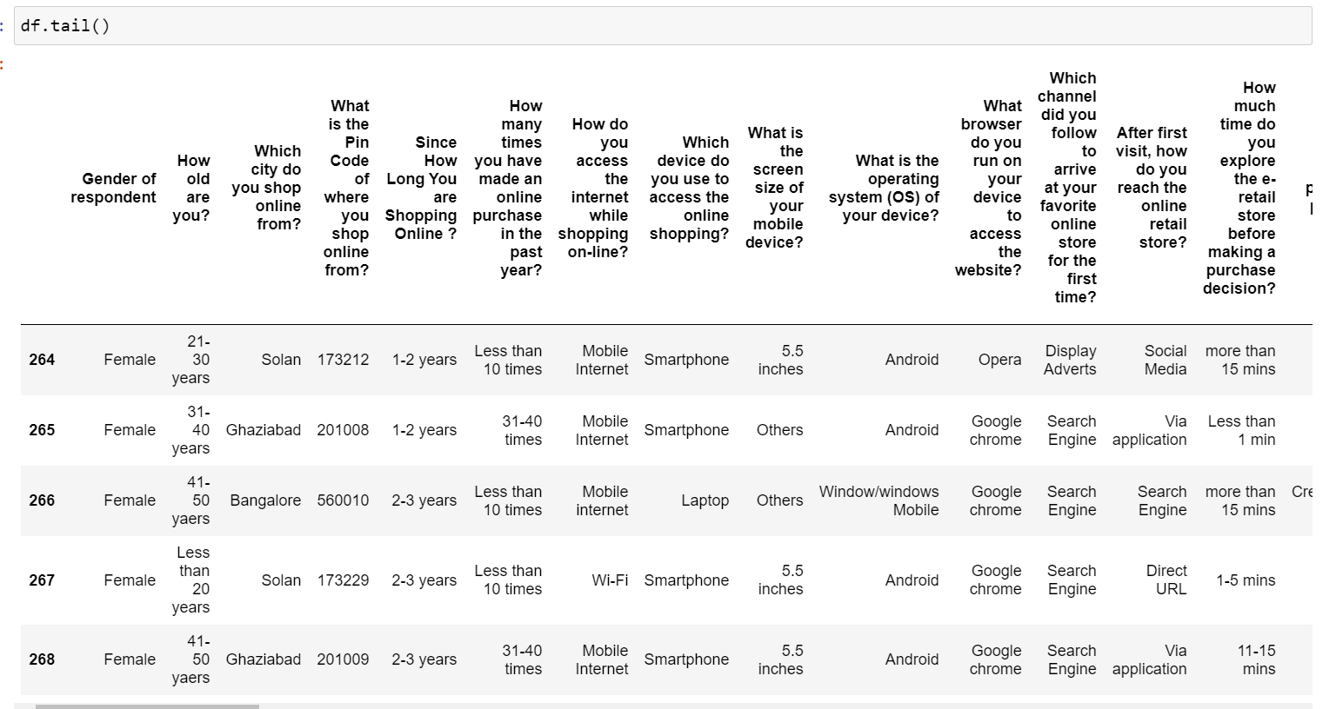
ABOUT THE DATASET:
This data set consist of data collected from various people residing and doing online purchase in India

Slide 6
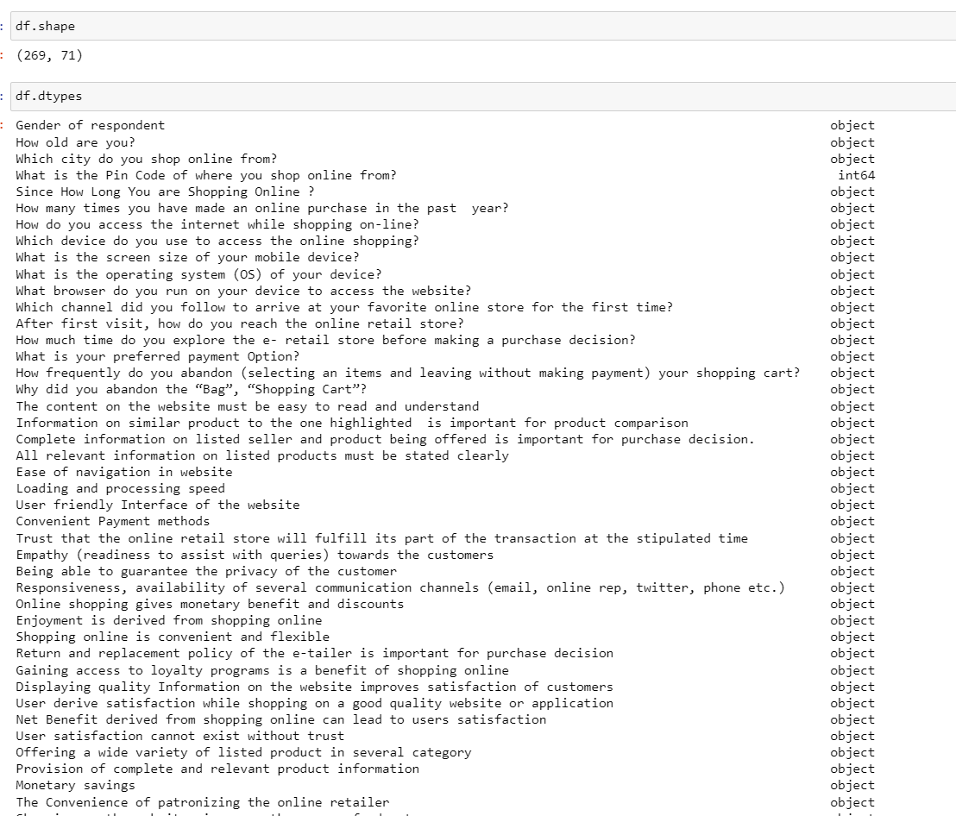
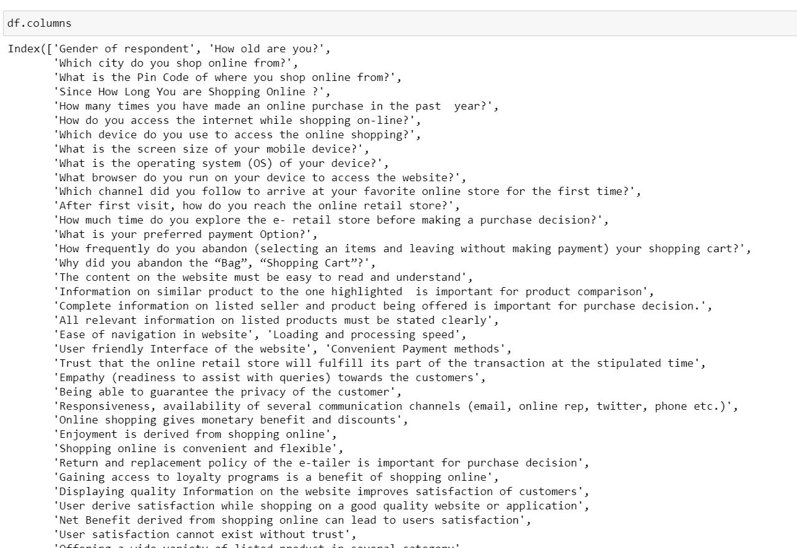
ABOUT THE DATASET:
Using various methods like df.shape, df.columns, df.head(), df.tail() , df.info(),df.nuinque to get some idea about the data we are handling

Slide 7
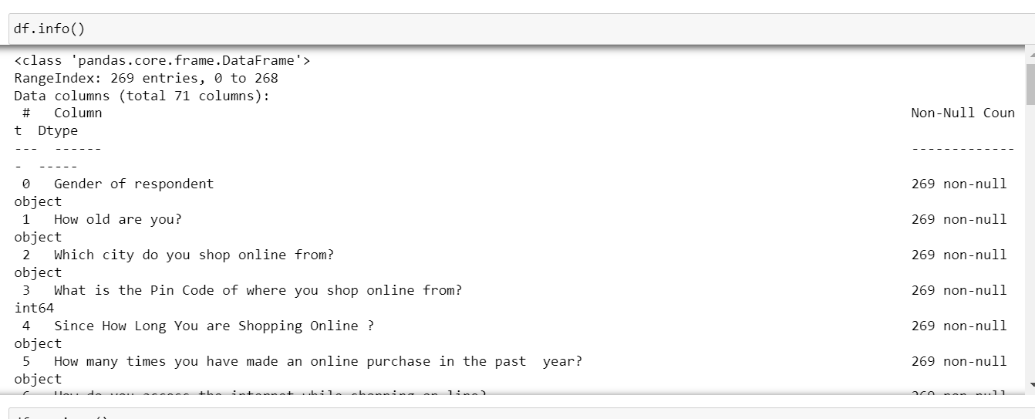
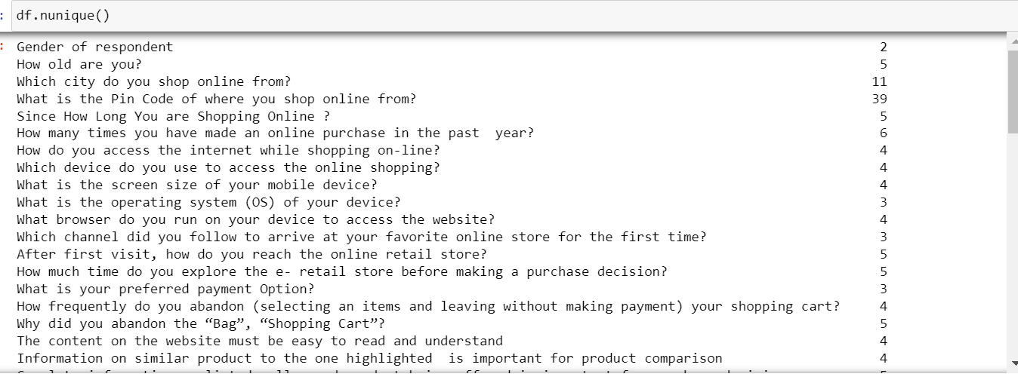
ABOUT THE DATASET:

Slide 8
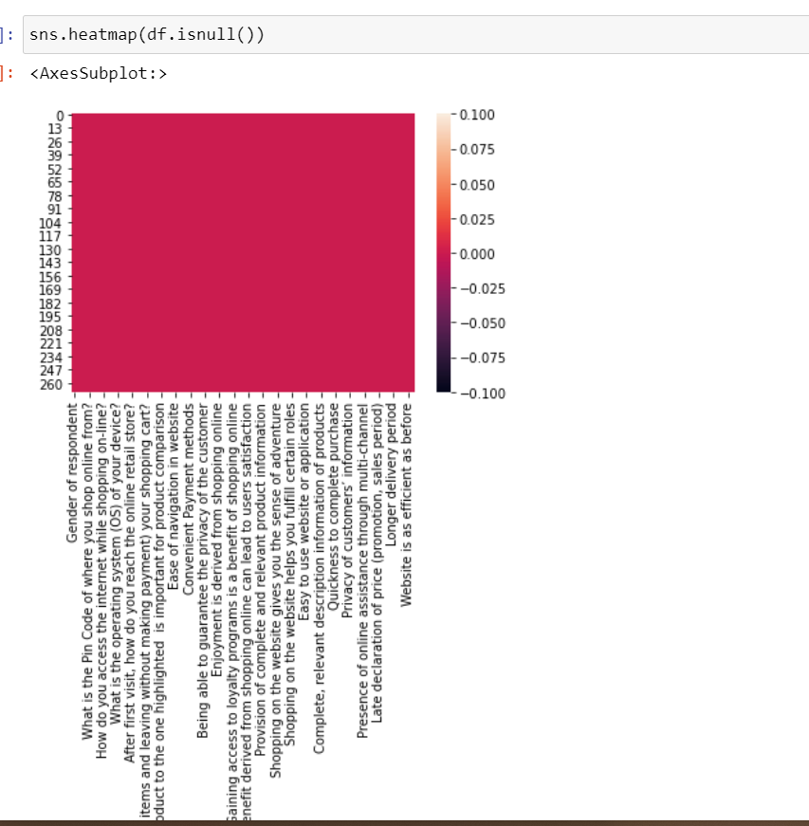
NULL VALUE CHECK:
Checking null values present in data by heatmap

Slide 9
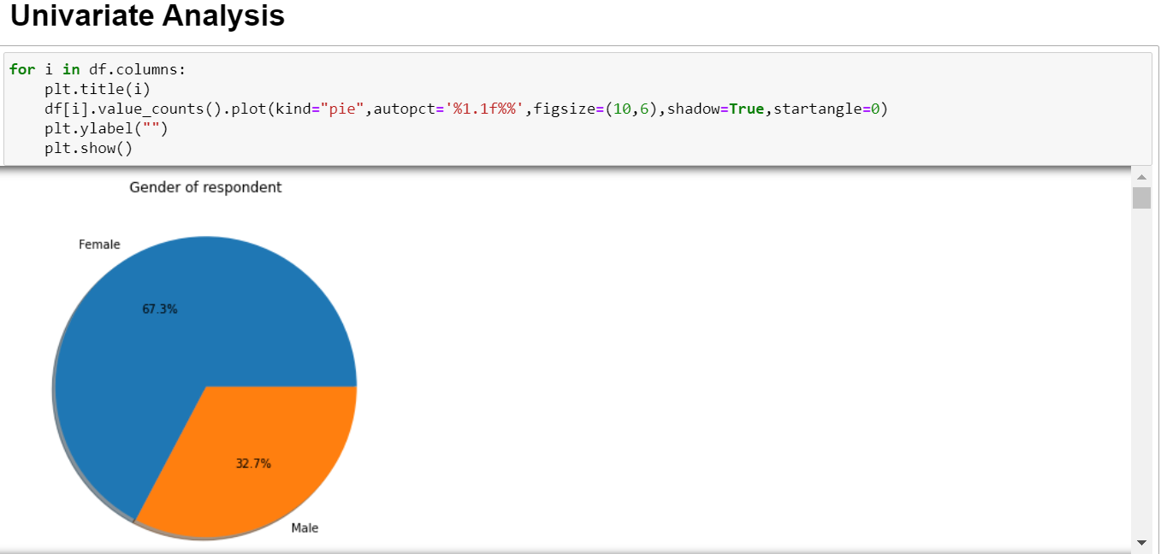
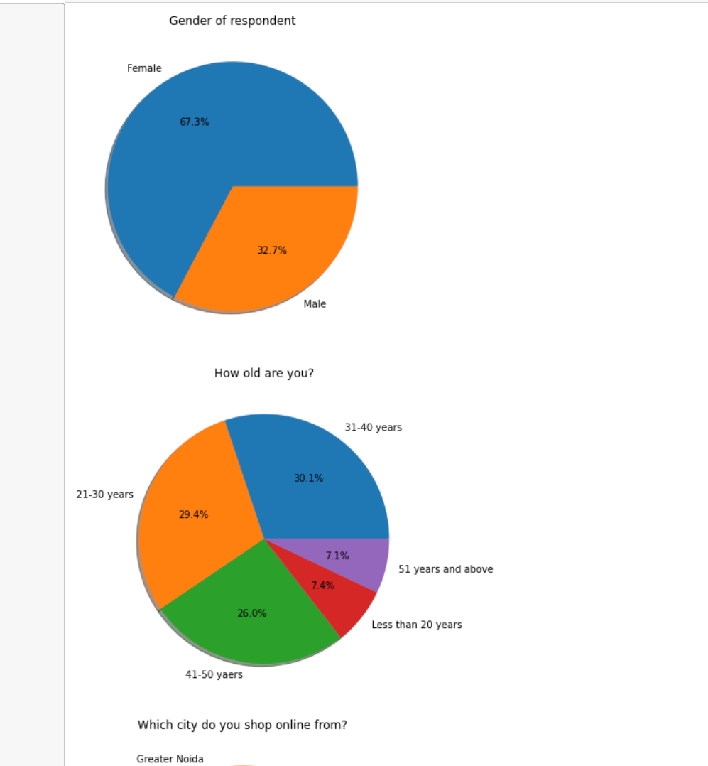
UNIVARIATE ANALYSIS:
Using for loop to plot pie chart for all columns

Slide 10
FIRST IMPRESSIONS ON DATASET: BASED ON UNIVARIATE ANALYSIS
The dataset has all values in object except pin code
There are no null values in data
The size of data is 269 Rows and 71 Columns
The dataset has female survey data nearly 67%
Survey conducted to people of age below 20 years is less only 7%
Data collected majority from Delhi and Noida compared to other parts of India

Slide 11
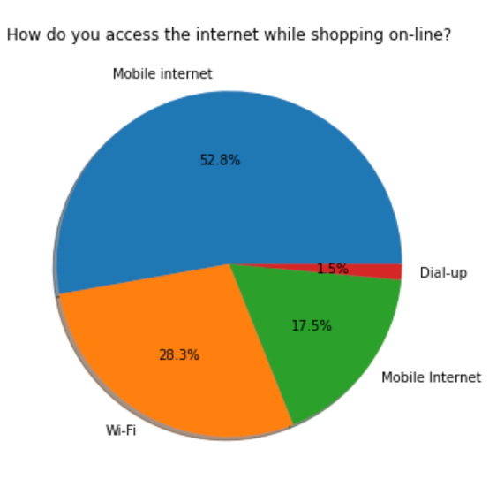
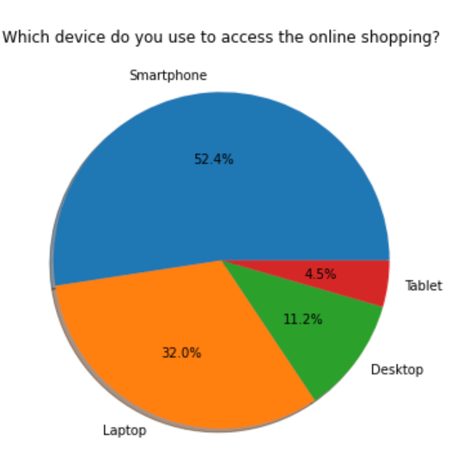
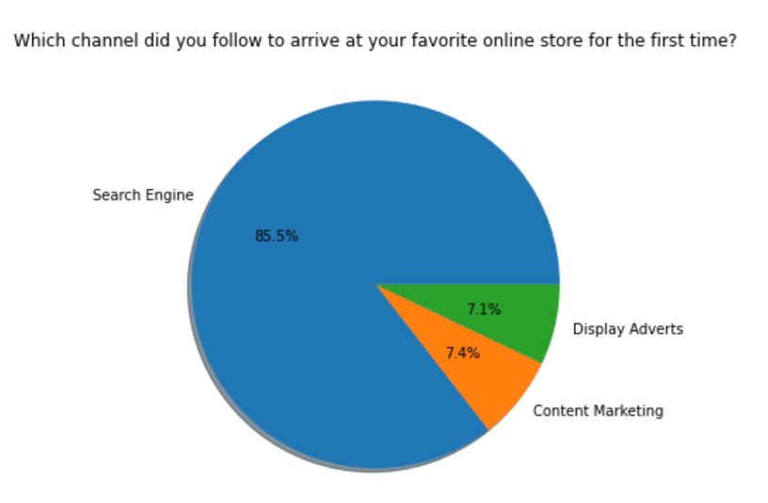
KEY FACTORS: BASED ON UNIVARIATE ANALYSIS
Mobile phone and mobile internet made it possible for this mass reach of e commerce sites
Search engine also plays a major role in attracting people to e commerce sites for first time

Slide 12
FEATURES CUSTOMER EXPECT FROM E COMMERCE SITES
BASED ON UNIVARIATE ANALYSIS
The content of website must be easy to read and understand
Information of similar product to be highlighted for comparison
Complete information of listed seller and product being offered is important for purchase decision
All relevant information on listed products to be stated clearly
Ease of navigation in website, loading and processing speed
User friendly interface of website, convenient payment methods
Trust that online retail store will fulfil its part of transaction at stipulated time
Empathy towards the customers, being able to guarantee the privacy of customer, responsiveness availability of several communication channels
Return And Replacement Is Much Expected

Slide 13
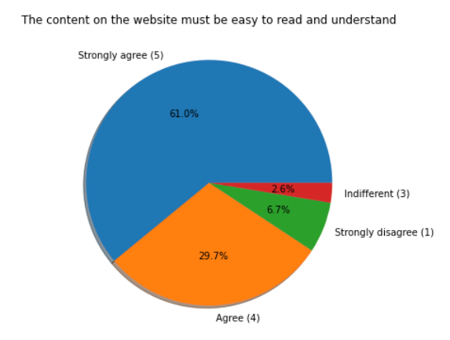
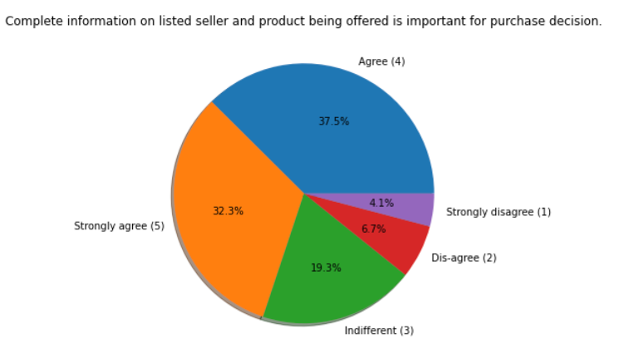
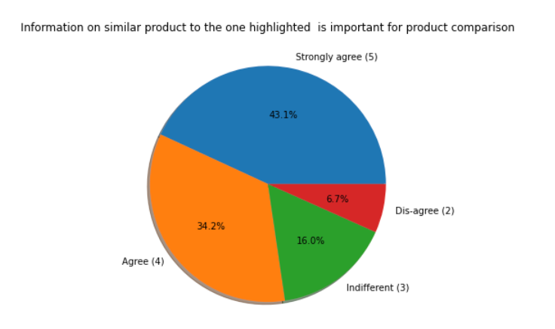
FEATURES CUSTOMER EXPECT FROM E COMMERCE SITES
BASED ON UNIVARIATE ANALYSIS

Slide 14
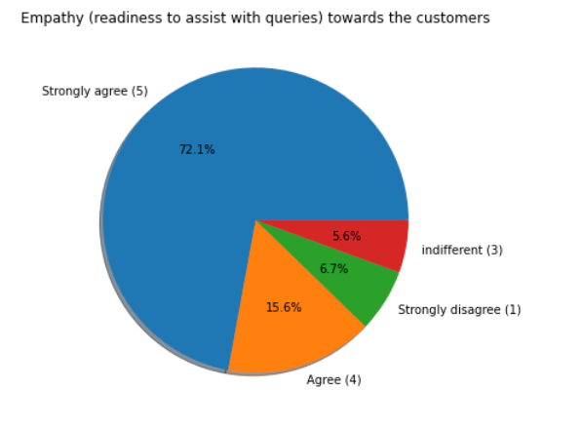
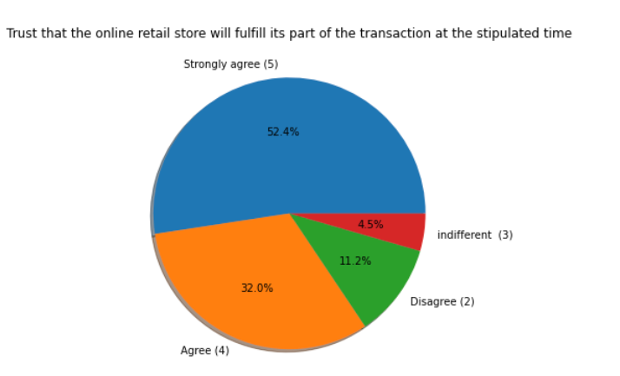
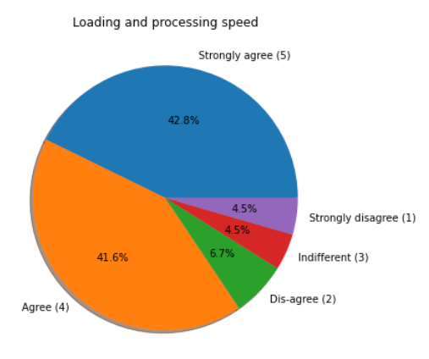
FEATURES CUSTOMER EXPECT FROM E COMMERCE SITES
BASED ON UNIVARIATE ANALYSIS

Slide 15
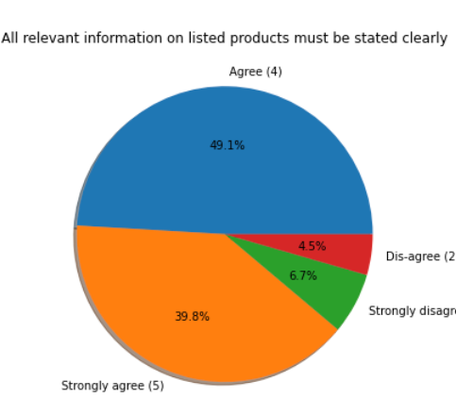
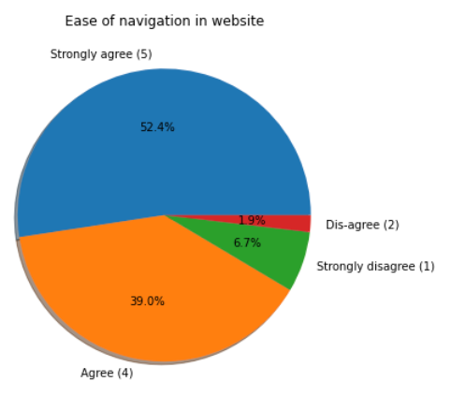
FEATURES CUSTOMER EXPECT FROM E COMMERCE SITES
BASED ON UNIVARIATE ANALYSIS

Slide 16
CUSTOMERS PREFER ONLINE SHOPPING FOR FOLLOWING:
BASED ON UNIVARIATE ANALYSIS
Online shopping gives monetary benefit and discounts
Shopping online is convenient and flexible
Enjoyment is derived from online shopping
Gaining access to loyalty programs is benefit of shopping online
Shopping on the website gives you the sense of adventure
Shopping on your preferred e tailer enhances your social status
The feel gratification shopping on your favourite e tailer
Getting value for money spent

Slide 17
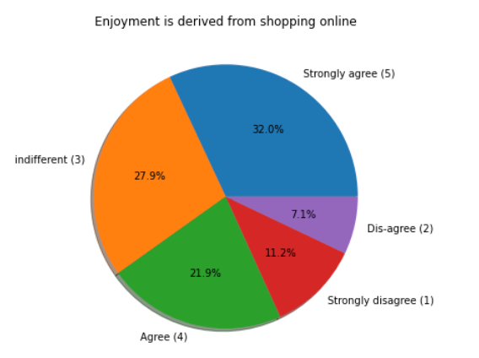
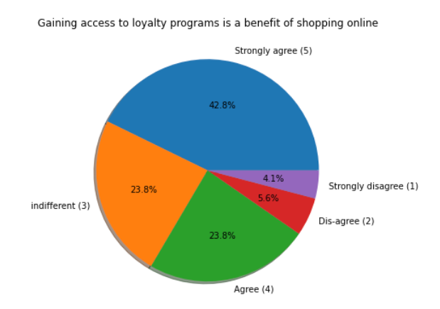
CUSTOMERS PREFER ONLINE SHOPPING FOR FOLLOWING:
BASED ON UNIVARIATE ANALYSIS

Slide 18
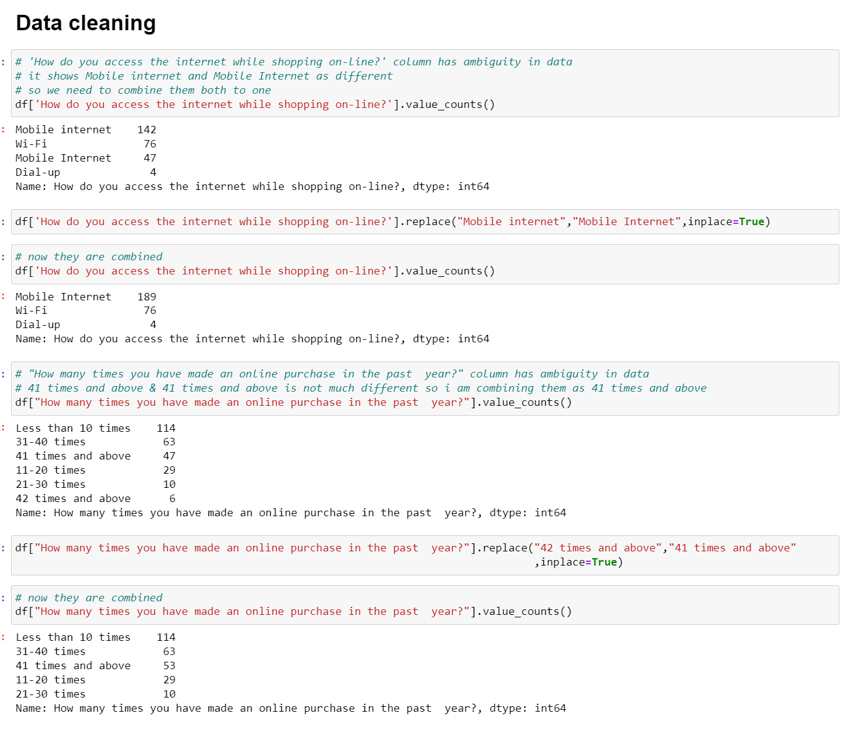
DATA CLEANING
BASED ON UNIVARIATE ANALYSIS SOME REDUNDANT DATA ARE COMBINED AND CLEANED

Slide 19
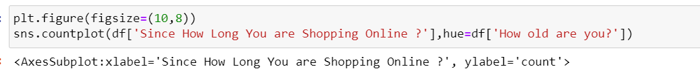
MATURITY OF ONLINE CUSTOMERS:
USING COUNT PLOT TO VISUALIZE

Slide 20
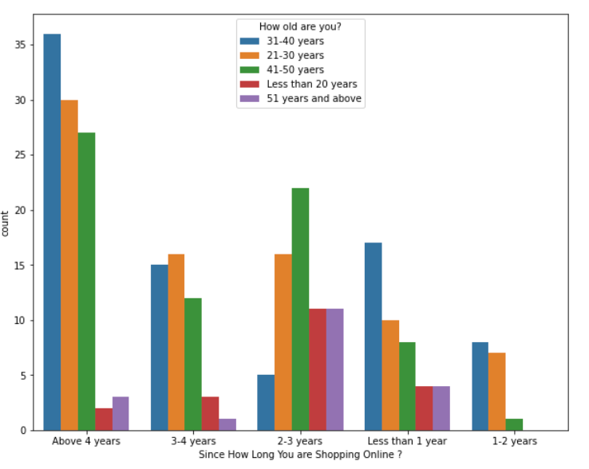
MATURITY OF ONLINE CUSTOMERS:
It seems online customer are matured enough as we see people are more who shop for more than 4 years
And people between age 31-40 do shopping online more than other age group
People in age below 20 and above 51 do online shopping very least amount of time

Slide 21
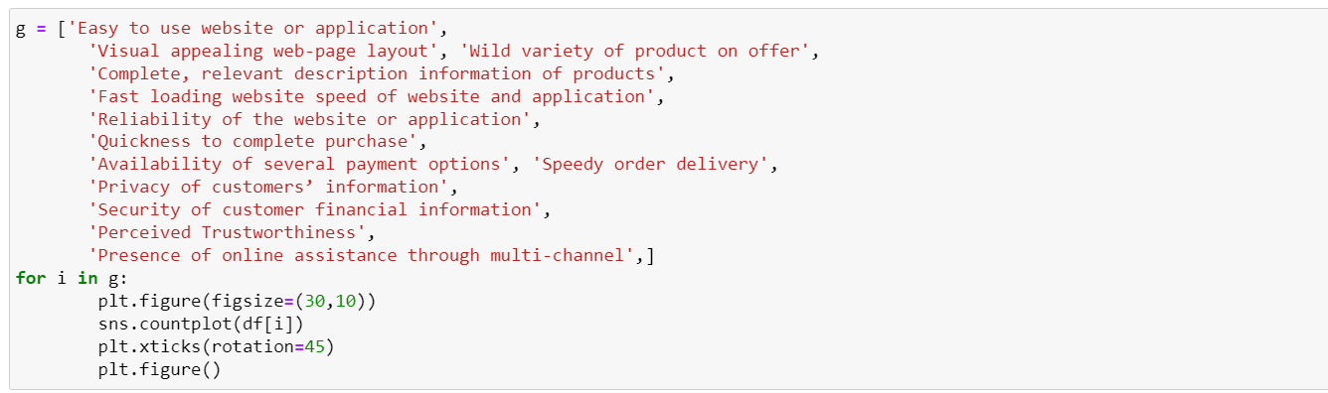
SET OF POSITIVE FEATURES ABOUT E COMMERCE PLAYERS:
CREATING LIST OF POSITIVE FEATURES AND USING FOR LOOP TO PLOT GRAPH

Slide 22
SET OF POSITIVE FEATURES ABOUT E COMMERCE PLAYERS:
The content of website must be easy to read and understand
Information of similar product to be highlighted for comparison
Complete information of listed seller and product being offered is important for purchase decision
All relevant information on listed products to be stated clearly
Ease of navigation in website, loading and processing speed
User friendly interface of website, convenient payment methods
Trust that online retail store will fulfil its part of transaction at stipulated time
Empathy towards the customers, being able to guarantee the privacy of customer, responsiveness availability of several communication channels
Return And Replacement Is Much Expected

Slide 23
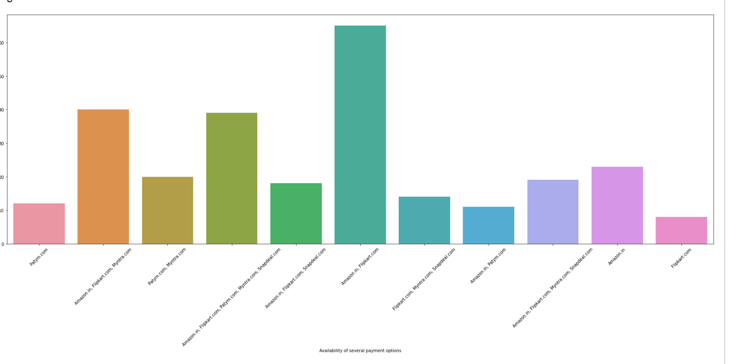
SET OF POSITIVE FEATURES ABOUT E COMMERCE PLAYERS:

Slide 24
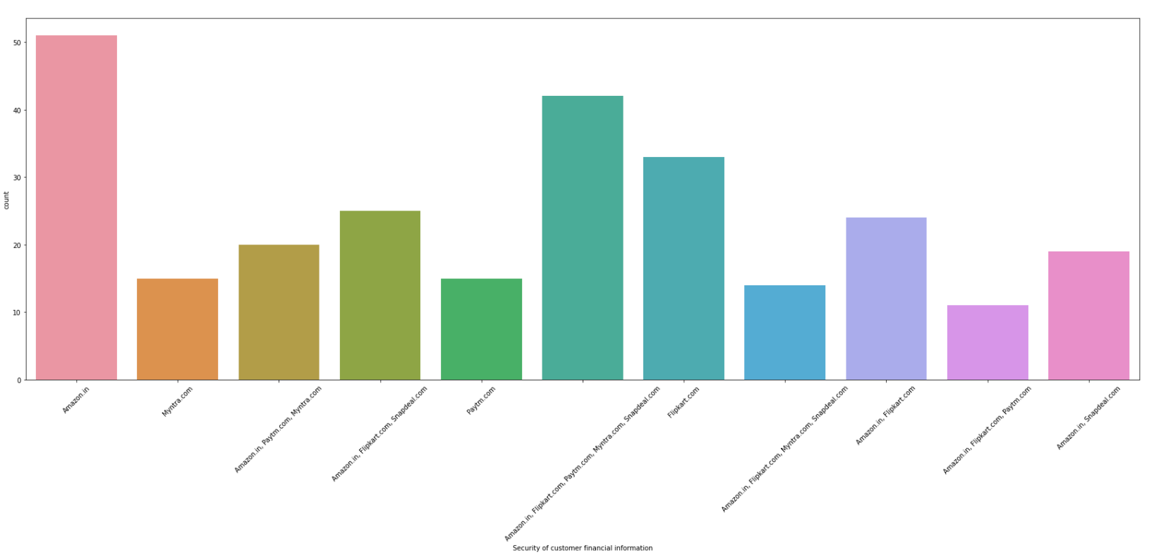
SET OF POSITIVE FEATURES ABOUT E COMMERCE PLAYERS:

Slide 25
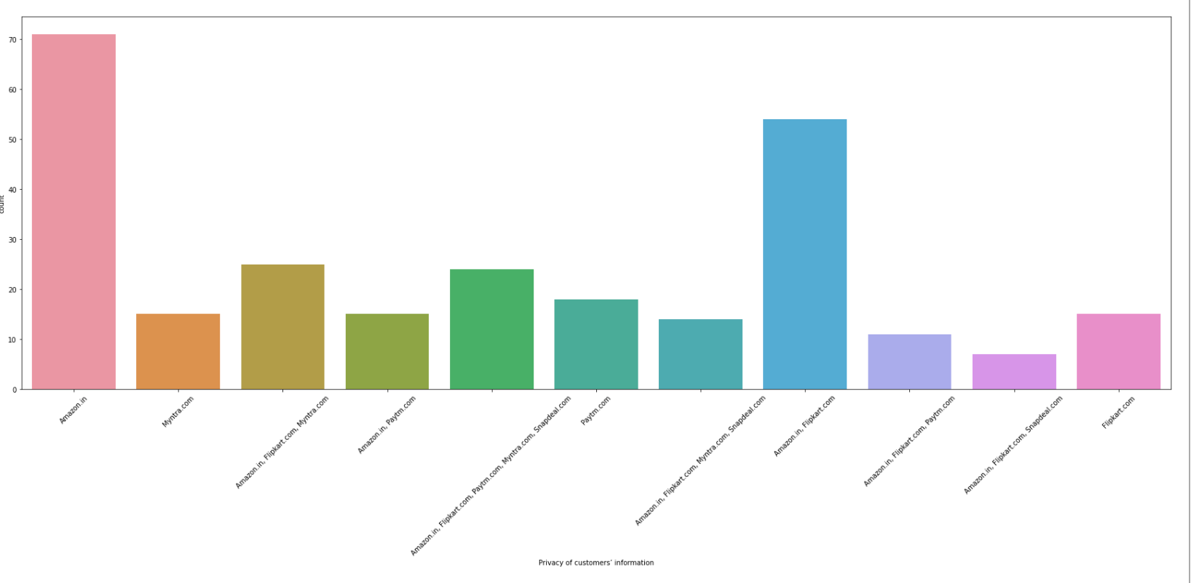
SET OF POSITIVE FEATURES ABOUT E COMMERCE PLAYERS:

Slide 26
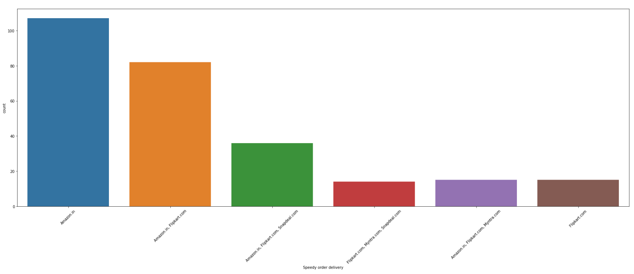
SET OF POSITIVE FEATURES ABOUT E COMMERCE PLAYERS:

Slide 27
SET OF POSITIVE FEATURES ABOUT E COMMERCE PLAYERS:
OBSERVATIONS:
All the positive features mentioned above Amazon and Flipkart seem to score best

Slide 28
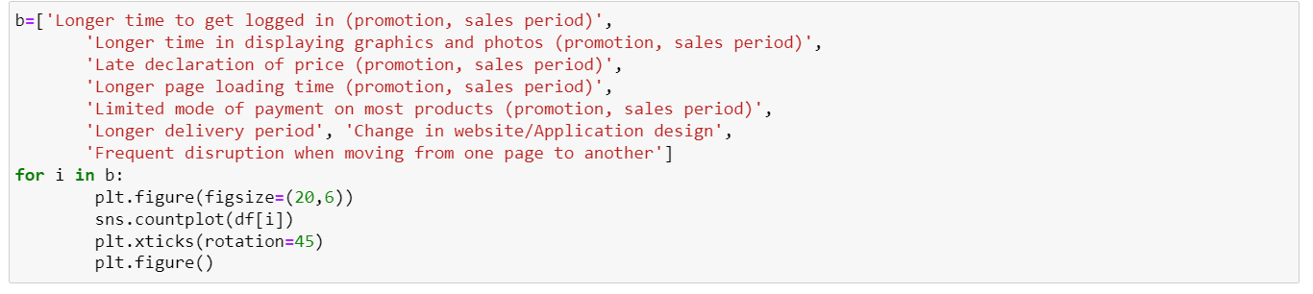
SET OF NEGATIVE FEATURES ABOUT E COMMERCE PLAYERS:
CREATING LIST OF NEGATIVE FEATURES AND USING FOR LOOP TO PLOT GRAPH

Slide 29
SET OF NEAGATIVE FEATURES ABOUT E COMMERCE PLAYERS:
Longer time to get logged in (promotion, sales period,
Longer time in displaying graphics and photos (promotion, sales period),
Late declaration of price (promotion, sales period),
Longer page loading time (promotion, sales period),
Limited mode of payment on most products (promotion, sales period),
Longer delivery period, change in website/application design,
Frequent disruption when moving from one page to another

Slide 30
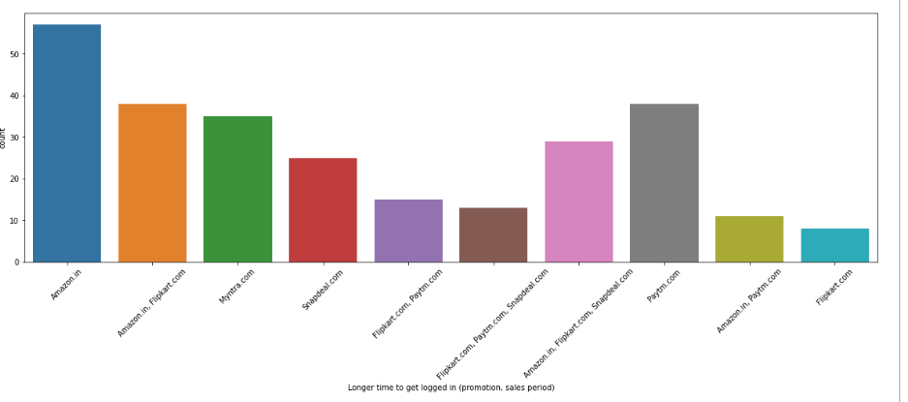
SET OF NEAGATIVE FEATURES ABOUT E COMMERCE PLAYERS:

Slide 31
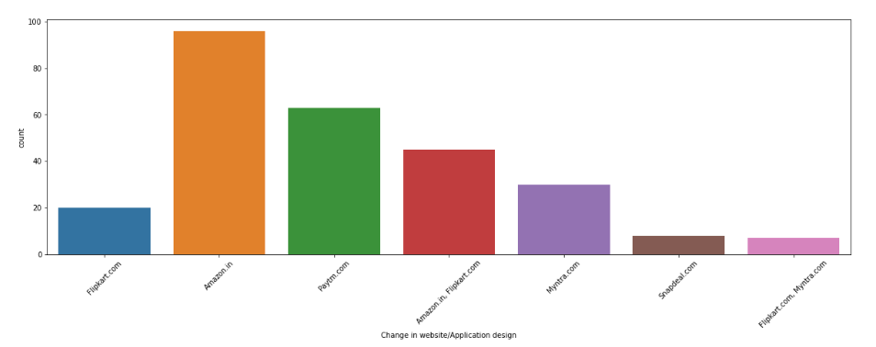
SET OF NEAGATIVE FEATURES ABOUT E COMMERCE PLAYERS:

Slide 32
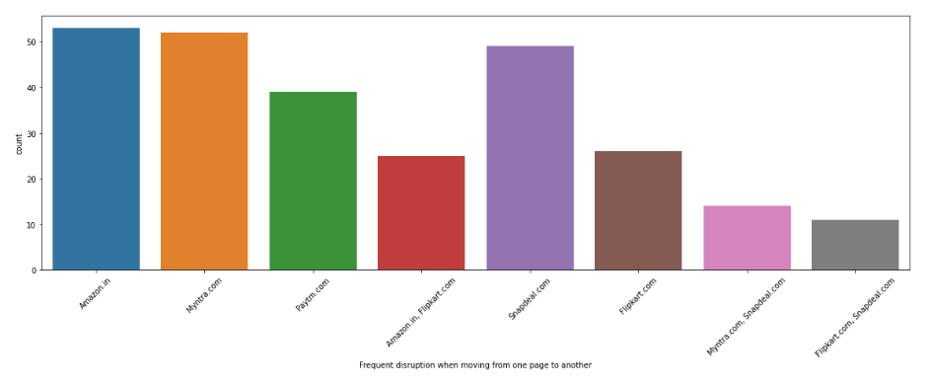
SET OF NEAGATIVE FEATURES ABOUT E COMMERCE PLAYERS:

Slide 33
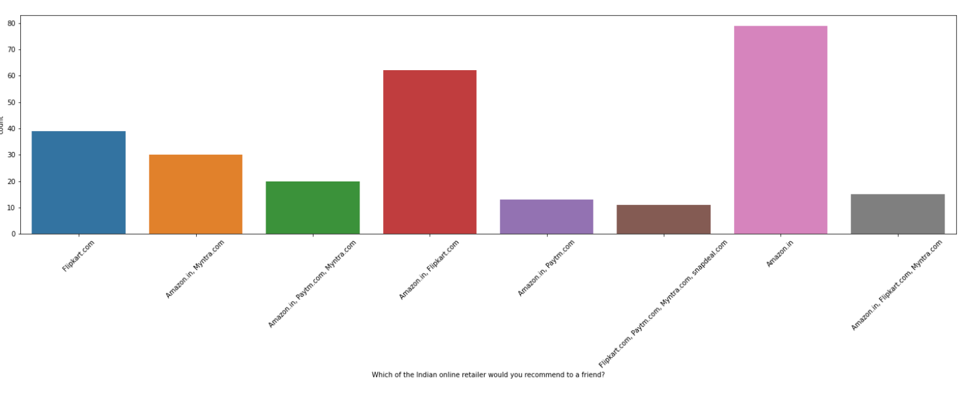
SET OF NEAGATIVE FEATURES ABOUT E COMMERCE PLAYERS:

Slide 34
SET OF NEGATIVE FEATURES ABOUT E COMMERCE PLAYERS:
OBSERVATIONS:
All the Negative features mentioned above Amazon and Flipkart seem to have more negative score

Slide 35
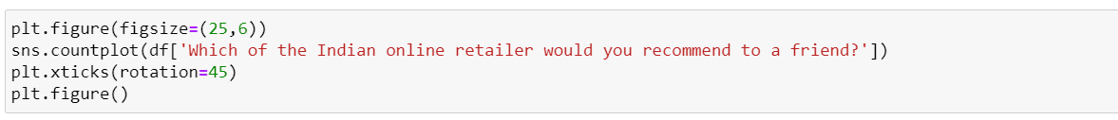
CUSTOMER’S BEST E COMMERCE PLAYER:
Plotting using count plot for which Indian online retailer would you recommend to your friend

Slide 36
CUSTOMER’S BEST E COMMERCE PLAYER:

Slide 37
CUSTOMER’S BEST E COMMERCE PLAYER:
OBSERVATION:
EVEN THOUGH NEGATIVE POINTS ARE HIGHER FOR AMAZON AND FLIPKART PEOPLE PREFER THEM AND TO BE NOTED POSITIVE POINTS ALSO HIGHER FOR AMAZON AND FLIPKART

Slide 38
CONCLUSION:
THE KEY REASON INDIA BECOME TOP HOTSPOT FOR E COMMERCE PLAYER’S ARE HIGH INTERNET AND MOBILE PENETRATION. WE CAN SEEN IN SURVEY DATA MORE THAN 50% ONLINE PURCHASE HAPPEN THROUGH MOBILE PHONES AND MOBILE INTERNET
AND FOR FIRST TIME ECOMMERCE SHOPPERS MORE THAN 80% ARRIVE THROUGH SEARCH ENGINE FOR SITES. THIS IS KEY FACTOR FOR ECOMMERCE PLAYER THEY SHOULD STAY ON TOP ON SEARCH ENGINE RESULTS TO GET BETTER REACH
CUSTOMERS USE ONLINE SHOPPING PORTAL FOR MAIN FACTORS LIKE, CONVENIENCE, VALUE FOR MONEY, GRATIFICATION FEELING AFTER SHOPPING IN ONLINE & BENEFITS FROM LOYALTY PROGRAMS.

Slide 39
CONCLUSION:
CUSTOMERS EXPECT SOME IMPORTANT FEATURES FROM E COMMERCE PLAYER’S WHICH INCLUDE RETURNS AND REPLACEMENT CONVENIENCE, TRUST WORTHINESS OF SELLERS LISTED IN E COMMERCE SITES, EASY NAVIGATION, BETTER DESIGNED WEBSITES, CONVINENT PAYMENT METHODS.
ON FINAL NOTE AMAZON AND FLIPKART MANAGED TO BE SUCCESFUL WINNERS AMONG OTHER COMPETITIORS. FROM MY POINT OF VIEW AFTER ANALSING THIS DATA THE MAIN REASON IS BECAUSE OF THEIR POWER TO MAKE PEOPLE TRUST THEM BY OFFERING VARIOUS FEATURES LIKE EASY RETURN AND REPLACEMENT AND OFFERS TO MAKE CUSTOMER FEEL SATISFIED AFTER EVERY PURCHASE WHICH IS MAIN REASON THAT TRIGGER REPEAT PURCHASE MENTALITY.

Slide 40
THANK YOU FOR THE OPPORTUNITY :

